Slide 1
Towards The Systematic Design of Model Animation:
Key Ingredients and General Guidelines
Moussa Amrani, Abdelkader Ouared,
Pierre-Yves Schobbens
Modeling Language Engineering (Mle) Workshop
Co-Located with MoDELS 2022
Monday 24th October, Montréal, Canada
Notes:
Hello, everyone. Thanks for coming., my name is ouared abdelkader I’m a post doc researcher from Faculty of Computer Science / NaDI, University of Namur Namur, Belgium
it my pleasure to be here with you
In this presentation, i will share with you a part of my research intitiled:
Towards The Systematic Design of Model Animation:
Key Ingredients and General Guidelines

Slide 2
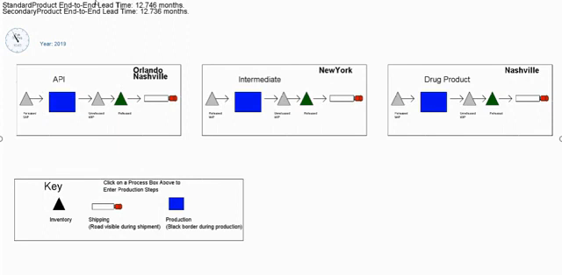
Model Animator (MA)
Supply Chain Model Animation
https://www.youtube.com/watch?v=GVJO2PuJD6w&t=2s
Notes:
Let me start by an example of Model Animator
- As you can see, this video illustrates a simulation visualization of the Supply Chain system through a Model Animator.
In this example the simulation behind was animation to provide more transparency and information on how this system under design behaves
The steps of simulations can be perceive by updating its visual elements attribute like changing color and position objects
- This animation enables designers and end users to trust, understand and monitor the system under design

Slide 3
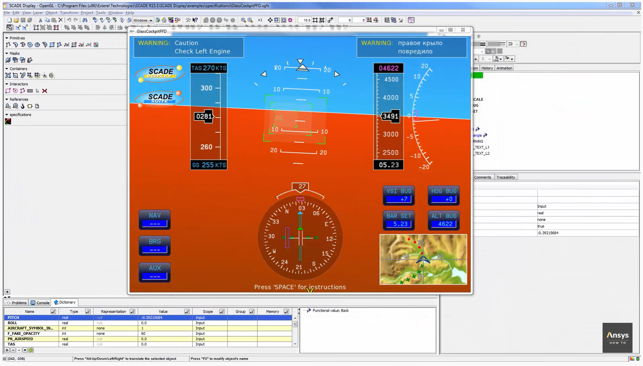



What we don’t address
https://www.youtube.com/watch?v=kaJfTS2WvEA
Notes:
-Another example, from the community of Modelling & Simulation based on a dedicated modeling language such as modelica, SCADA.
-This figure illustrates a Model animator that is a dashboard embedded in the windshield car vehicle.
-During driving the atmospheric properties like temperature, humidity and wind speed are captured in real time using sensors
-In our research we don't address this kind of simulation and animation challenges, because and because its complexity and the strict time constraints.

Slide 4



Roles in MDE
1
Metamodel Level
Domain-Specific Metamodeling Language
Transformation Language
Language
Designer
Conforms to
Conforms to
2
3
Model
Level
Model Definition
Transformation Specification
Modeller
Transformation Expert
Knows
Application
User
MA Designer (new role)
Notes:
As you know, in MDE we have Actors at different level, at the level of metamodel, we have language designer who is responsible to design a DSML
At the Model level, we found modeller, his task is to define a model that must be conform to MM
The third actor is transformation expert, his role is to define the language semantic and generate the application of end users
Here, we need to introduce a MA as new role, to define the animation corresponding to the MT execution,

Slide 5
Roles in MDE
1
Metamodel Level
Domain-Specific Metamodeling Language
Transformation Language
Language
Designer
Knows
Conforms to
Conforms to
2
3
Model
Level
Model Definition
Transformation Specification
Animation
Specification
Modeller
Transformation Expert
MA Designer
(new role)
Application
User
Notes:
As you know, in MDE we have Actors at different level, at the level of metamodel, we have language designer who is responsible to design a DSML
At the Model level, we found modeller, his task is to define a model that must be conform to MM
The third actor is transformation expert, his role is to define the language semantic and generate the application of end users
Here, we need to introduce a MA as new role, to define the animation corresponding to the MT execution,

Slide 6


What is a Model Animation ?
Visualization (aka. Rendering)
A rendering transformation assigns one (or more) concrete representation(s) to each abstract syntax element or group of elements in an input model, as long as the meta-model of the concrete syntax is defined explicitly.
Simulation
A simulation transformation defines the operational semantics of a modeling language that updates the modeled system’s states.
Inplace & Endogenous
Animation
Animation is the visualization of a simulation
p1:Pacman
in
C1: CELL
id = 1
MovePacman
1
right
2
1
right
2
in
in
CS
Rendering
MM
Parsing
Simulation
M_{CS}
M
Animation
Simulation
[1] Lúcio, Levi and Amrani, Moussa and Dingel, Juergen and Lambers, Leen and Salay, Rick and Selim, Gehan M. and Syriani, Eugene and Wimmer, Manuel. (2014). Model Transformation Intents and Their Properties. SoSyM 15(3), 647--684
Notes:
So what is a Model Animation:
We realized the presence of confusion in literature between the concepts of visualization, simulation and animation:
To clarify,
first, the visualization:
The simulation:
The Animation:

Slide 7
Coordinating Trafos and Animations
Executing one Transformation Unit (TU) triggers the execution of one, or several, Animation Unit(s) (Aus)
Operation 1
Operation 2
Operation 3
Operation 4
Animation 1
Animation 3
Animation 2
Animation 7
Animation 8
Animation 2
Animation 4
Animation 5
Animation 1
Animation 6
dependency
Animation 6
Notes:
The logic behind the Model Transformation capturing a DSL’s behavioural semantics.
The coordination between Animations with transformation chain, is guided BY TRAFOS: one step of transformation triggers one or several animation steps,
For instance, we can see from Figure:
The first transformation step corresponds to one AU step
The second and fourth transformation step correspond to 3 steps
And the third correspond to 5
The question here, how to orchestrated this execution between the both process ?

Slide 8

Coordinating Trafos and Animations
Executing one Transformation Unit (TU) triggers the execution of one, or several, Animation Unit(s) (Aus)
Operation 1
Operation 2
Operation 3
Operation 4
Animation 1
Animation 3
Animation 2
Animation 7
Animation 8
Animation 2
Animation 4
Animation 5
Animation 1
Animation 6
dependency
Animation 6
Notes:
The logic behind the Model Transformation capturing a DSL’s behavioural semantics.
The coordination between Animations with transformation chain, is guided BY TRAFOS: one step of transformation triggers one or several animation steps,
For instance, we can see from Figure:
The first transformation step corresponds to one AU step
The second and fourth transformation step correspond to 3 steps
And the third correspond to 5
The question here, how to orchestrated this execution between the both process ?

Slide 9
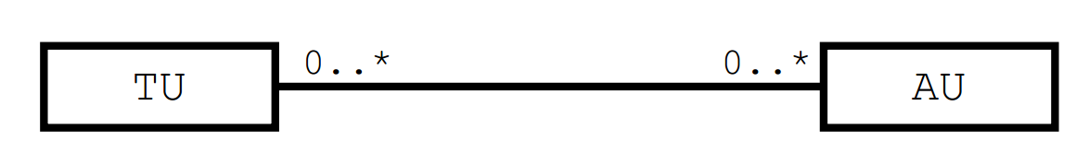
Decoupling TUs and AUs
Tackle the Lack of ﬂexibility in MA specifications
Enable the reuse of AUs
TU₁
AU₁
TU₁
AU₁
Dsl1
TU_{i}
AU_{k}
AU₂
Dsl2
TU_{j}
AU₃
Notes:
- In order to ensure this coordination between animation and transformation, we decide decoupling TUs and Aus.
- MT is decomposed into smaller TU and the animations that are accessed by the TU are represented in the respective unit.
- Moreover, to achieve more flexibility in MA animation and Enable the reuse of AUs , the concept of mapping will be used different mapping scenarios: 1-to-1, N-to-1, 1-to-N, N-to-M for relating Each the TUs and the AUs
- In the first scenario of mapping, we attach one AU to one AU . This means that that a single UT to be visualized in multiple MA ( flexibility concept)
-Second, we attach many more granular sets of AUs with one TU.
- And we can reuse AU for several TU of different DSL.
-

Slide 10
Decoupling TUs and AUs
Tackle the Lack of ﬂexibility in MA specifications
Enable the reuse of AUs
TU
0..*
0..*
AU
AU₁
TU_{i}
AU₁
TU₁
AU₁
Dsl1
AU₂
TU₁
AU₃
TU_{j}
AU₂
TU₂
AU₂
AU₄
Dsl2
TU_{k}
AU₅
Notes:
- In order to ensure this coordination between animation and transformation, we decide decoupling TUs and AUs.
- MT is decomposed into smaller TU and the animations that are accessed by the TU are represented in the respective unit.
- To achieve more flexibility in MA animation and Enable the reuse of AUs , the concept of mapping will be used different mapping scenarios: 1-to-1, N-to-1, 1-to-N, N-to-M for relating Each the TUs and the AUs
- In the first scenario of mapping, we attach one AU to one AU . This means that that a single UT to be visualized in multiple MA ( flexibility concept)
-Second, we attach many more granular sets of AUs with one TU.
- And we can reuse AU for several TU of different DSL.
-

Slide 11
3 Key Challenges
Explicitly define CS for easily expressing MA;
Build an MA language to express AU in a compositional way,
Explicitly relate MA units with their transformation counterparts
Notes:
- Following our vision to provide a Reusable and flexible components for designing MA Tools (Enable the reuse of AUs For different DSL)
- Three Key Challenges must be discussed:
Explicitly define CS for easily expressing MA;
Build an MA language to express AU in a compositional way,
Explicitly relate MA units with their transformation counterparts

Slide 12
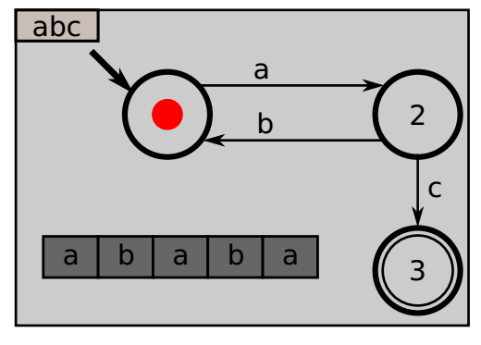
A Simple FSM Metamodel ☺
FSM
1 fsm
name : String [0..1]
alphabet : Integer [1..*]
« enumeration »
Kind
REGULAR
INITIAL
FINAL
1..* states
* transitions
1 token
1 src
Token
1 current
State
Transition
1 word
name : String
1 tgt
trigger : String
Word
Letter
* letters
label : String
A turing Machine for (a+(ba)*+c
Notes:
To discuss the three challenge, consider the Turing Machine presented in this figure, the execution of the machine begins from the START state o state 3,
Each transition means read one character from the current cell
This system can be presented by a Simple FSM Metamodel

Slide 13
(Visual!) Concret Syntax
Notes:
First Visual Aspect or Concrete Syntax

Slide 14
Complex Rendering Patterns
Rendering
Visual Representation
Final
State
State
...
Initial
Initial
Regular
Regular State
Final
Initial State
Regular
Final State
Transition
Transition
Notes:
To explain the challenges related to a complex rendering patterns,
let’s consider the following example that illustate CS of FSM , here we have the visual representation of FSM metamodel (Kind state : symbol for INITIAL and FINAL states and transition)
We can consider three Usage
- The metamodel element can be mapped by visual element of concrete syntax
- For instance the state of FSM metamodel can be represent by a class State that is a generalization of three class initial, final and regular
- So, to visualize this model, we associate for each class the corresponding visual element of the CS

Slide 15
Complex Rendering Patterns
Rendering
Visual Representation
Final
State
State
...
Initial
self.kind == INITIAL
Regular
Regular State
FSM
self.kind == FINAL
Initial State
1 fsm
...
1..*
states
« enumeration »
Kind
State
self.kind == REGULAR
Final State
INITIAL
REGULAR
FINAL
kind: Kind
Transition
Transition
Notes:
Other representation of the State symbol based on enumerate these three kind of states,
in this case to visualize the CS , we must write the queries explicitly using query languages (like OCL-style constraint.) to define the rendering function

Slide 16
Complex Rendering Patterns
Rendering
Visual Representation
Final
State
State
...
Initial
self == self.fsm.initial
Regular
Regular State
FSM
self == self.fsm.final
Initial State
1 fsm
...
1..*
states
« enumeration »
Kind
State
not (... or ...)
Final State
INITIAL
REGULAR
FINAL
kind: Kind
Transition
Transition
FSM
1 fsm
...
1..*
states
State
1 initial
...
1 final
Notes:
In the third scenario, the INITIAL, FINAL and REGULAR states are defined based on references.
Son to definition the rendering function is the set of OCL expression based on references evaluation
From this example, one can see from a simple DSL , a multiple rendering scenarios that must be considered
In fact, we need a complex rendering patterns to handle these scenarios,

Slide 17
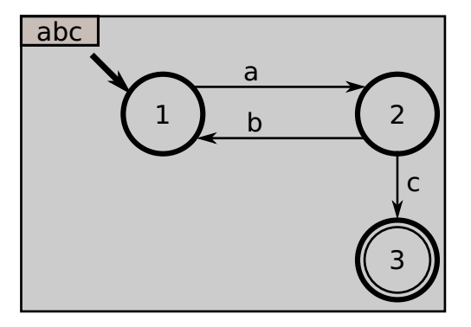
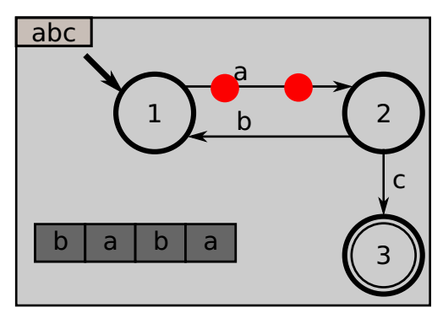
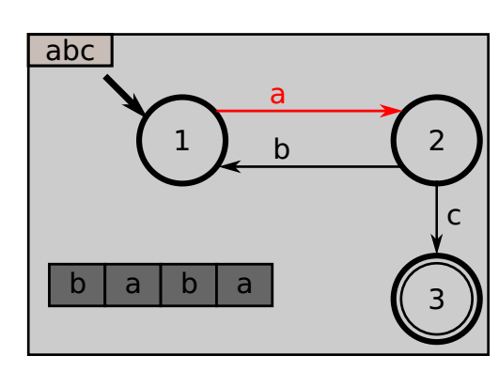
Providing “snapping” capabilities
Alternative representation of MA
e.g. Two categories of Animations
Showing the progression on the word
Showing the FSM’s current state
Variability model animation specification
Sequential
Concurrent
Timed approach
Providing “snapping” capabilities
Notes:
Other properties must be considered to define the rendering function -> is to provide “snapping” capabilities
The animation of this model can be define in multi way.
Let consider a example of FSM DSL, here we have two categories of Animations
- Showing the progression on the word
- Showing the FSM’s current state
So to animate the fire unit transformation that is inside the accept transformation, we can consider alternative representation with designers preferences
- In the sequential mode:
- In concurrent mode
- The third approach is to
To provide this variability in animation specification, we must provide Providing “snapping” capabilities

Slide 18

Integrating “insideness” natively
Example of simultaneous image contrast illusion
e.g. PacMan kills Ghost
Parallel:
① Appear(Pacman)
② Disappear(Ghost)
Sequential:
③ Disappear(Pacman)
④ Appear(Pacman)
Visual
Eﬀects
Sequences
of images chained
obtained
Illusion
Notes:
- Other properties must be considered in rendering function is to Integrating “insideness” natively
- To more understand the problem, consider the scenario of Pacman game when persona Pacman eats ghost
- As we can see, this illusion can be specifies by sequence of animation in sequential and parallel mode
- So a complex visual effect, can obtained by Sequences of images chained to show this illusion

Slide 19
Supporting animations natively
Fast Update of Visual Features
Browsing, customize/extend/modify
e.g., the position, size, color
Conjoined/Nested Element Block
Usability Mechanisms
Using the Graphical Elements
Using Visual Language
e.g. Block Oriented Modeling, Causal Modeling
Visual Editor Workspace
Visual Features
- Position
- size
- color, ..
Graphical Elements
MA Designer
Edit Element
Notes:
- In the Complex Rendering Patterns, we must support animations natively, regarding the high demands of UI/UX design usability,
- This feature means the capabilities to assist designers create a successful animation by browsing the existing graphical element, enriching, editing and customizing them.
So, we believe that providing a visual language, allows designers to take advantage of flexibility and reusability of its library component.
- A Visual language provide AM design elements as a visual interface to allows editing of the properties of the selected elements in the canvas and makes a drug-and-drop style for the animation building
- This make it more an animation design flexible and fully unlock the CM engineering potential.

Slide 20
MA Specification
Notes:
Now we move to the second challenges : MA Specification

Slide 21
De-/Re-Constructing MA
Following the approach in [1] for Model Transformation, we need to decouple
Model Animation Effects, from
Model Animation Scheduling
MA Framework
A primitive Combinators
separate
an elements
UA Eﬀects Library
Creation Eﬀects
Basic animation eﬀects
WorkSpace
WorkSpace
Deletion Eﬀects
CTRL 1: Loop
shape
CS components Library
Action Eﬀects
Sequantial
Table
CTRL2: time
Parallel
table
Graphical
Elements
Path Motion
TexBox
combinators outside
Organized and scheduled
C k
Geometric
Combinators m
Element n
delay
Repetitors
//
Embedding
the scheduling inside
the UAs
Complex Animations
[1] Syriani, Eugene and Vangheluwe, Hans (2010). De-/Re-constructing Model Transformation Languages. In Workshop on Graph Transformation and Visual Modeling Techniques.
DOI: http://dx.doi.org/10.14279/tuj.eceasst.29.407
Notes:
- Following the approach in Syriani et al., 2014 for Model Transformation, we need to decouple
Model Animation Effects, from
Model Animation Scheduling
- An overview of this architecture is shown in this Figure.
- The primitive blocks of animation can be selected from a library
- This animation effect can be scheduled using composer and attached to the target element of the concrete syntax using a simple drag-and-drop interface
- This architecture allows novices to simply focus on the semantic challenges and promote portability, in which MA is defined independently of DSL

Slide 22
MA Effects
Appearing
● ● ●
APP
ZOOMIN
Disappearing
● ● ●
DAPP
ZOOMOUT
Action
● ● ●
Change Color
Change Style
Notes:
- We have identify atomic and derived AU
- For Atomic MA Effect, we have
- Appearing Effect:
- Disappearing Effect:
- Action Effect:
Other animation like path follow can be derived from these primitives

Slide 23
UA Scheduling
- For UA Scheduling, we have identify two Theoretical Approaches
- The first the Scheduling is Embedding the scheduling inside the UAs, this means that defined inside each unit animation using pre-condition and post-condition of each unit animation
- The second method is to define combinators of sequential and parallel mode outside of UAs
Theoretical Approaches for UA Scheduling
Embedding the scheduling inside the UAs
Define combinators outside of UAs
A11
A12
A13
B1
B2
||
;
;
B1
B2
A11
;
A12
A13
Notes:
For UA Scheduling, we have identify two Theoretical Approaches
- The first the Scheduling is Embedding the scheduling inside the UAs, this means that defined inside each unit animation using pre-condition and post-condition of each unit animation
- The second method is to define combinators of sequential and parallel mode outside of UAs

Slide 24
Relating
How to relate to the DSL at hand ?
How to synch TU and AU ?
Notes:
The third challenge is how relating AU and TU

Slide 25


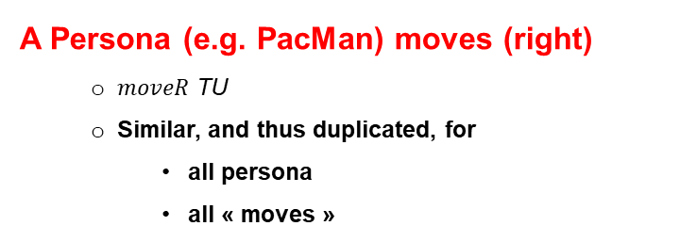
UA Parameterization
A Persona (e.g. PacMan) moves (right)
$moveR$ TU
Similar, and thus duplicated, for
all persona
all « moves »
A Transition is fired, changing the current State
TU fire, defined inside the general transformation accept
SCORE 0
^{Viz}M_{2x2}
abc
tl
right
tr
2
in
left
in
up
up
down
down
3
bl
right
br
a
b
a
b
a
left
in
Define an generic Animation Unit APP-DAPP that
Make a specific element
Disappear from a location, and
Appear into another location
Notes:
- UA can be parametrized to support the reuse aspect.
- Here an example of move Right of Pacman, so the similar UA be duplicated by for all moves, just by parameterize the persona and the direction
- Also the optional parameter of the frequency of appearance or disappear used in order to Pacman follow a path between CELLS
- This UA move right can be reused for other DSL, like fire token, in which Pacman is substituted by token and CELL is substituted by place
So, we must define Define an generic Animation Unit APP-DAPP that
Make a specific element
Disappear from a location, and
Appear into another location

Slide 26

UA Parameterization
BLINK
DAPP
;
APP
period = period
what
on
what
from
period
what
period
what
where
where
period = 1 second
tl
period = 1 second
tl
Notes:
-So we have two primitives DAPP with two parameters what and on APP with two parameters what and from
-This atomic primitive can compose to build a block of animation BLINK
-So to use this block, just attach Pacman and CELL and customize the period of composer

Slide 27
UA Parameterization
DAPP
DAPP
what
on
rendering
what
on
what
where
what
where
tl
p1: Pacman
c1: CELL
id = 1
Notes:
We apply the expression of the rendering function of this custom block animation, we can replace the element of the model by its corresponding graphical elements.
- The resulting block can be executed in an environment supporting a given visual language.

Slide 28

MT < > MA Coordination
How to coordinate the MT Engine with AM Engine ?
Locate relevent TUs
Annotating TUs, i.e. @Step annotation
Enable Communication between Engines
Interactive Exploration Services
Transformation Specification
class PacMan { @Step def boolean moveR() { if(self.in.right != null){ self.in = self.in. Right}
GeMoC approach for debugging [Erwan B., et al. 2018]
breakpoint
stepInto
stepOver
stepOut
play
examine
steps
examine model state
Notes:
New we neet to be able to notify the MA engine that a TU is currently executed, so the MA engine performs the animation.
Two problems here:
1.How do we locate relevant TUs inside the overall transformation?
2.What is the communication process between both engines?
To solve the problem, we have proposed to use the GeMoC approach for debugging:
- Annotations for TU: This is used in a declarative way by the metaprogramming paradigme (e.g., the @Step annotation provided by Kermeta).
- Communication protocol based on Interactive Exploration Services provided by the most debugger of MT engine . This services helps to get the the execution step and the state model before and after execution of unit transformation

Slide 29
Conclusion
TU
0..*
0..*
AU
Key Challenges
Concrete
Syntax
Complex Rendering Patterns
Lack of ﬂexibility in MA
Enable the reuse of AUs
MA
Specification
UA
Composer
UA
DSL Tools to perform MA alongside of MT
MA Designer
MT < > MA
Coordination
class PacMan { ... @Step def boolean moveR() {
MT
MA
@Step
Notes:
At the-end;
-To summarize, I have presented a the Systematic Design of Model Animation as key Ingredients and General Guidelines
-i have noticed that MA designer need a DSL Tools to perform MA alongside of MT
-This because a Lack of ﬂexibility in MA and to enable the reuse of AUs
-Our vision is to the use the concepts of mapping between AU and TU
-Three Challenges have been identified behind this vision
-First, for the concrete syntax the challenge is how to provide a complex rendering patterns to handle the variability specification in AS
-Secondly, MA specification by decoupling : Model Animation Effects, from Model Animation Scheduling
-Finally, the coordination between the both engine is based on annotation and communication
As future work, we are now in the phase of implementing our framework and validation through a case study
—----------------
Tank you for your attentions

